Slide 1
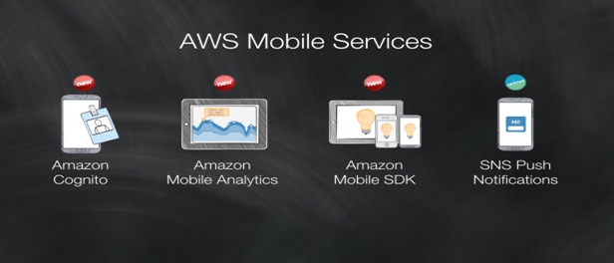
AWS Mobile Services

Slide 2
AWS Mobile Services
AWS Amplify: AWS Amplify makes it easy to create, configure, and implement scalable mobile applications powered by AWS. Amplify seamlessly provisions and manages your mobile backend and provides a simple framework to easily integrate your backend with your iOS, Android, Web, and React Native frontends.
Amazon Cognito: Amazon Cognito lets you add user sign-up, sign-in, and access control to your web and mobile apps quickly and easily. With Amazon Cognito, you also have the option to authenticate users through social identity providers such as Facebook, Twitter etc.
Amazon Pinpoint: Amazon Pinpoint makes it easy to send targeted messages to your customers through multiple engagement channels.
AWS Device Farm: AWS Device Farm is an app testing service that lets you test and interact with your Android, iOS, and web apps on many devices at once, or reproduce issues on a device in real time.
AWS AppSync: AWS AppSync is a serverless back-end for mobile, web, and enterprise applications.

Slide 3
AWS Migration
What you'll accomplish
Create a private Git repository using AWS CodeCommit. This is the destination where your project will be hosted.
Migrate your project to your CodeCommit repository. You can migrate either an existing Git repository or an unversioned project that is stored locally.
What you'll need before starting:
An AWS Account
Git repository or local content:
Git Experience:
AWS Experience

Slide 4
AWS Migration
AWS CodeCommit: AWS CodeCommit is a fully-managed source control service that hosts secure Git-based repositories. It makes it easy for teams to collaborate on code in a secure and highly scalable ecosystem. CodeCommit eliminates the need to operate your own source control system or worry about scaling its infrastructure. You can use CodeCommit to securely store anything from source code to binaries, and it works seamlessly with your existing Git tools.

Slide 5
AWS Analytics
What you'll accomplish
Set up a Kinesis Agent on data sources to collect data and send it continuously to Amazon Kinesis Data Firehose.
Create an end-to-end data delivery stream using Kinesis Data Firehose.
Process incoming log data using SQL queries in Amazon Kinesis Data Analytics
Load processed data from Kinesis Data Analytics to Amazon Elasticsearch Service to index the data.
Analyze and visualize the processed data using Kibana.
What you'll need before starting:
An AWS Account
IT Experience:
AWS Experience

Slide 6
AWS Analytics
Log analytics is a common big data use case that allows you to analyze log data from websites, mobile devices, servers, sensors, and more for a wide variety of applications such as digital marketing, application monitoring, fraud detection, ad tech, games, and IoT. In this project, you will use Amazon Web Services to build an end-to-end log analytics solution that collects, ingests, processes, and loads both batch data and streaming data, and makes the processed data available to your users in analytics systems they are already using and in near real-time. The solution is highly reliable, cost-effective, scales automatically to varying data volumes, and requires almost no IT administration.

